Slide 1
Planet watchers -
assignment
By Matan Lasry

Slide 2
The mission:
•Build a single-page-application (SPA).
•Upon loading the application, load two random Sentinel 2 images (via API) over Israel, with less than 30% clouds.
•The application should have two buttons:
a) “Replace” – replace the previous images with two new images with same selection criteria.
b) “Brighten” – increase image brightness by 10%.
About Sentinel Hub:
Sentinel Hub is a multi-spectral and multi-temporal big data satellite imagery service, capable of fully automated archiving, real-time processing and distribution of remote sensing data and related EO products. Users can use APIs to retrieve satellite data over their AOI and specific time range from full archives in a matter of seconds.

Slide 3
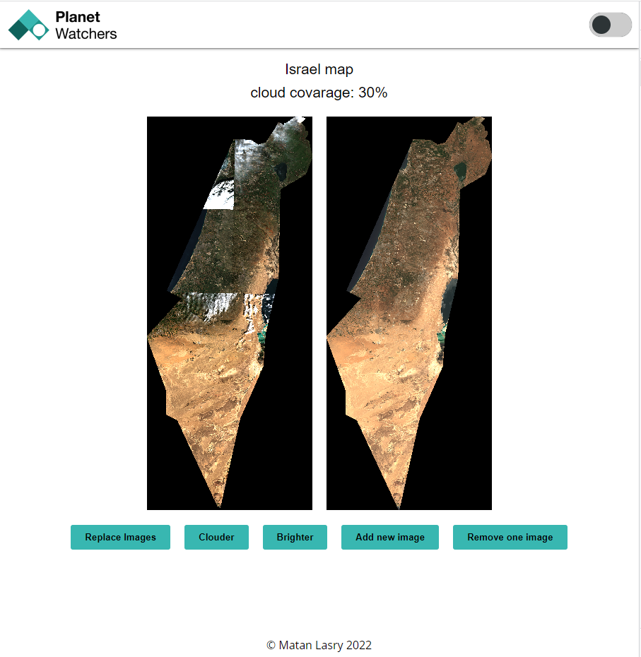
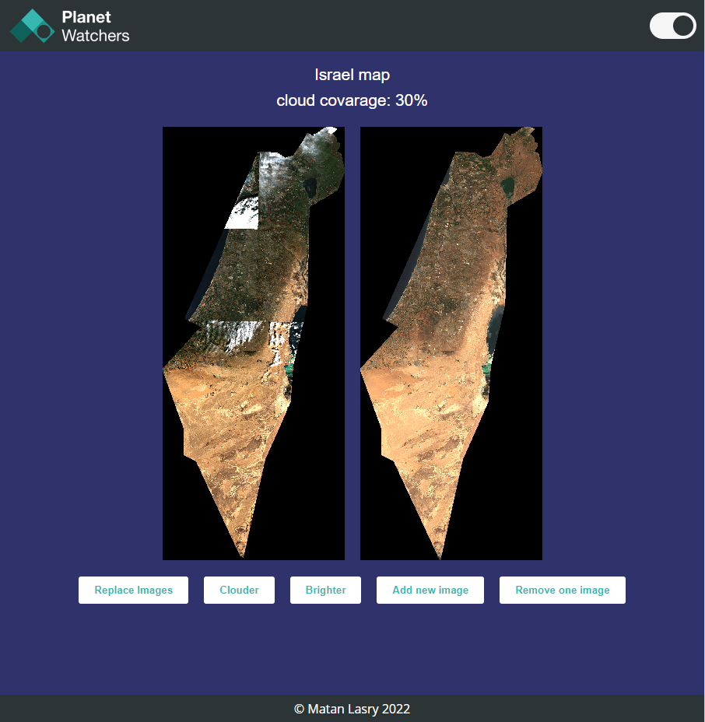
Main page

Slide 4
Task Summary
The goal was to orientate in the API in order to be able to follow the task requirements, So in the first few hours I only tried to send simple requests and figure out how to build the request body correctly and not get error code 400, The structure of the object is a little bit complex and unclear until I saw the API reference and opened it, it made a lot of sense from thereon. I refactored the code built the application with the features as required and tried and implement loader and debounce for the performance and UX.

Slide 5
Technical details about the assignment and solutions
After I wrote everything down I figured out something strange about the cloud cover and saw it's not exactly the percentage mentioned and I start to look into it, Played with the dates a little bit, started with 6 months apart from each other, and go to 1 year but still it didn't quite help with the problem so I might figure is related to the sentinel API because the percentage was accurate and everything was by the API docs with no errors or any message about wrong input or something.

